Slide 1
Modular C#
Modules in C#: Where Did We All Go Wrong.
Ian Cooper
@ICooper

Slide 2
Who Are you?
I am a polyglot coding architect with over 20 years of experience delivering solutions in government, healthcare, and finance and ecommerce. During that time I have worked for the DTI, Reuters, Sungard, Misys, Beazley, Huddle and Just Eat Takeaway delivering everything from bespoke enterprise solutions, 'shrink-wrapped' products for thousands of customers, to SaaS applications for hundreds of thousands of customers.
I am an experienced systems architect with a strong knowledge of OO, TDD/BDD, DDD, EDA, CQRS/ES, REST, Messaging, Design Patterns, Architectural Styles, ATAM, and Agile Engineering Practices
I am frequent contributor to OSS, and I am the owner of: https://github.com/BrighterCommand. I speak regularly at user groups and conferences around the world on architecture and software craftsmanship. I run public workshops teaching messaging, event-driven and reactive architectures.
I have a strong background in C#. I spent years in the C++ trenches. I dabble in Go, Java, JavaScript and Python.
www.linkedin.com/in/ian-cooper-2b059b
Notes:
Walk through the agenda briefly. Let the audience know we'll get practical and example-driven.
Outline of the talk (sections as bullets):
DDD to RDD: What’s missing, and where RDD fits
Key ideas: responsibilities, roles, collaborations
THE EXAMPLE: Modeling with CRC cards in practice
RDD’s place in modern development: DDD, TDD, and agility

Slide 3


Slide 4
Modular Design
Why should you care about modular design?

Slide 5
Designing with Modules
95% of the words [about software architecture] are spent extolling the benefits of “modularity” and that little, if anything, is said about how to achieve it. Glenford J. Myers (1978)

Slide 6
The Fundamental Law
C(P) > C(½P) + C(½P)
Due to complexity: It is always easier (and cheaper) to create two small pieces rather than one big piece if the two small pieces do the same job as the single piece. This is because combining two problems in one piece forces us to deal with the unneeded interactions between the two pieces
— Yourdon & Constantine, 1979

Slide 7
Divide and Conquer
Modular software is based on the simple principle of divide and conquer
• Manageably small, solvable separately
• Lowers cognitive load, reduces coupling
Of course, everyone has a different definition of "manageably small”
Notes:
This is our thesis. Yourdon and Constantine proved this mathematically back in the 70s - if you can divide a task into independent subtasks, the total cost is less than solving them together. C(P) > C(½P) + C(½P). But the key word is "independent". If your pieces aren't truly independent, you're not winning - you're just adding coordination overhead.

Slide 8
The Promise
Modular software is simpler to maintain
Information Hiding — an effective module hides decisions, lowering cognitive load (Parnas)
Minimize change complexity — changes affect only the hiding module; fewer scheduling problems from dependency chains (Yourdon, Constantine)
Black Box Tests validate decisions — without knowing implementation details (Yourdon, Constantine)
Defects are localized — limiting scope of error searching (Yourdon, Constantine
Notes:
"A well-defined segmentation of the project effort ensures system modularity. Each task forms a separate, distinct program module. At implementation time each module and its inputs and outputs are well-defined, there is no confusion in the intended interface with other system modules. At checkout time the integrity of the module is tested independently; there are few scheduling problems in synchronizing the completion of several tasks before checkout can begin. Finally, the system is maintained in modular fashion; system errors and deficiencies can be traced to specific system modules, thus limiting the scope of detailed error searching."
This comes from David Parnas' seminal paper, "On the Criteria To Be Used in Decomposing Systems into Modules", written in 1971--over 50 years ago at the time of this writing. The well-defined "separate, distinct program modules" covers about half of the suggested benefits of microservices, and we've been able to do that for fifty years.

Slide 9
What is a Module?
Definition

Slide 10
What is a Module?
"A module is a responsibility assignment"
— Parnas, 1972
Logical unit with interface + hidden implementation
Deal with the name, not the details (abstraction)
Don't couple to the details (information hiding)
Easier collaboration, changes confined to a module
Treat as a Black Box – easier to reason about
Unit Tests target a Black Box; Integration Tests are between Black Boxes
Notes:
Parnas's definition is key: not "a chunk of code" but "a responsibility assignment". A module owns something - a decision, a capability, a piece of knowledge. The interface tells you what it does; the implementation is hidden. This is abstraction (deal with the name) plus information hiding (don't depend on internals).

Slide 11
Information Hiding
The key insight
Hide design decisions that are likely to change (Parnas)
Data Structures
Algorithms
External Dependencies
If a decision is hard to change later, hide it now

Slide 12
Deep vs Shallow Modules
John Ousterhout's insight in a Philosophy of Software Design
Interface
Interface
Impl
Implementation
Deep: Narrow interface, deep implementation
Shallow: Wide interface, shallow implementation
Notes:
John Ousterhout's visual heuristic. A deep module has a small interface hiding substantial complexity - that's what we want. A shallow module exposes almost as much as it hides - the abstraction isn't paying for itself. When you find yourself passing lots of parameters or configuring lots of options, you might have a shallow module.
Reference: A Philosophy of Software Design

Slide 13
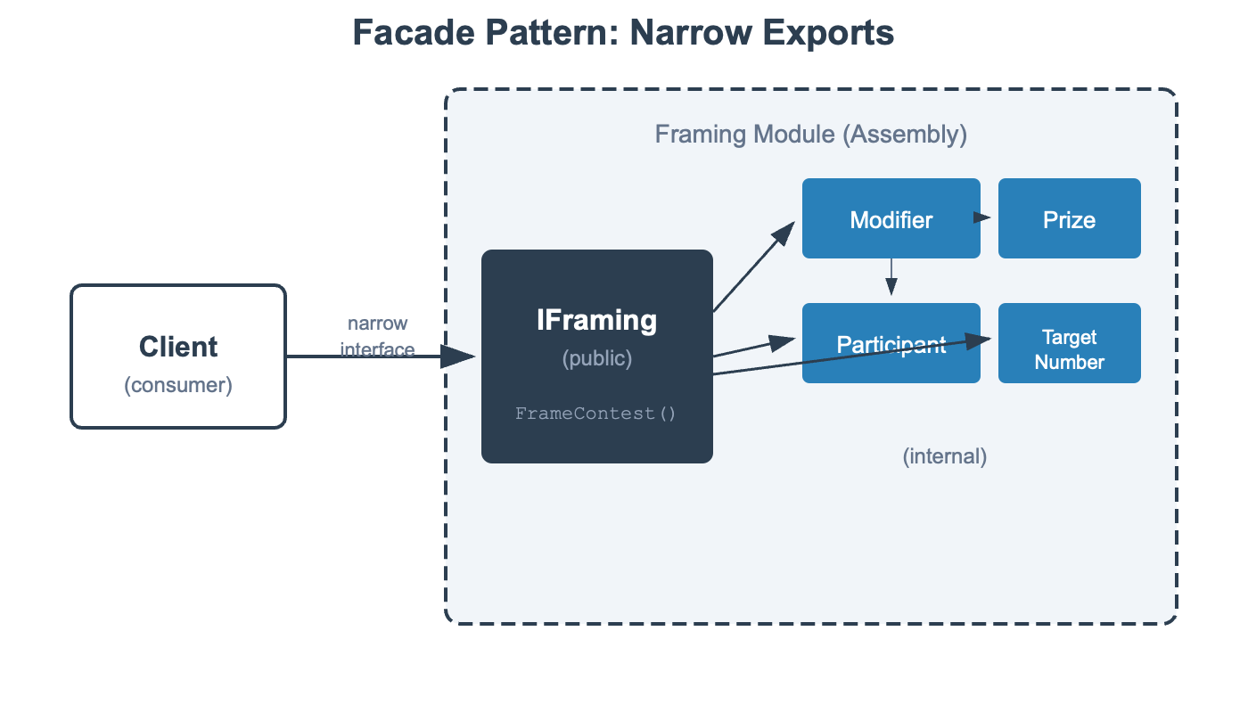
Facade
Create Deep Modules Using A Facade
Notes:
John Ousterhout's visual heuristic. A deep module has a small interface hiding substantial complexity - that's what we want. A shallow module exposes almost as much as it hides - the abstraction isn't paying for itself. When you find yourself passing lots of parameters or configuring lots of options, you might have a shallow module.
Reference: A Philosophy of Software Design

Slide 14
C# Modules
What are modules in C#

Slide 15
C# Module Mechanisms
Mechanism | Information Hiding
Method | Method body hidden behind signature
Class | Access Modifiers: Private access modifier hides class implementation; has methods
Namespace | None – controls visibility only; can span many assemblies
Assembly | Access Modifiers: Hides private or internal, only exposes public.
Preferred Module: Information Hiding (Parnas) + Deep (Ousterhout) => Assembly
Notes:
• Namespace — organization, no encapsulation• Class — encapsulation via private/public• Assembly — true information hiding (internal)

Slide 16
C# Access Modifiers
Mechanism | Information Hiding
Public | Export – visible outside the module
Internal | Local – implementation details of the module
Private | Class – implementation details of a class
Look for opportunities to hide details in your module by making a class internal
Notes:
• Namespace — organization, no encapsulation• Class — encapsulation via private/public• Assembly — true information hiding (internal)

Slide 17
Test at Module Boundaries
Test the interface, not the internals
No InternalsVisibleTo
NEVER use `InternalsVisibleTo` to expose internal classes for testing.
Internal classes should NOT be driven by unit tests directly.
Internal classes should emerge as implementation details through refactoring:
1. First, implement exported behavior in the public class (keep it simple)
2. As complexity grows, extract internal helper classes through refactoring
3. Tests always go through the public interface - internal classes are covered by those tests

Slide 18
Modules Are Not Layers
MyApp.sln
│
│ ── src/
│ │ ── MyApp.Web/MyApp.Web.csproj
│ │ ── MyApp.Application/MyApp.Application.csproj
│ │ ── MyApp.Domain/MyApp.Domain.csproj
│ │ ── MyApp.Infrastructure/MyApp.Infrastructure.csproj
This is a common .NET anti-pattern; your modules may be organized by layers (see later), but it is not a layer. Don’t use assemblies as layers.
Notes:
• Namespace — organization, no encapsulation• Class — encapsulation via private/public• Assembly — true information hiding (internal)

Slide 19
Folders are not Modules
MyApp.sln
│
│ ── src/
│ │ ── MyApp.Web/MyApp.Web.csproj
│ │ ── Features
| | ── Orders
│ | ── Create
│ │ ── CreateOrderCommand.cs
│ │ ── CreateOrderHandler.cs
│ | ── CreateOrderValidator.cs
│ | ── Cancel
| …
| | ── Customers
│ | ── GetById
│ | ── Register
This is a common .NET anti-pattern; a folder is not a module. It cannot do information hiding. Do not use folders as modules.
Architecture Tests are NOT a good alternative (pathological-coupling)
Notes:
• Namespace — organization, no encapsulation• Class — encapsulation via private/public• Assembly — true information hiding (internal)

Slide 20
Use An Assembly As A Module
MyApp.sln
│
│ ── src/
│ │ ── Framing.csproj
│ │ ── Framer.cs
| | ── Modifier.cs
| | ── Ability.cs
| | ── Rating.cs
| | ── Participant.cs
| │ ── Resolution.csproj
| | - DiceRoller.cs
| | - DiceRoll.cs
…
Each assembly is a module. We can use folder organization within the module if it becomes large, separating exports from details for example.
Notes:
• Namespace — organization, no encapsulation• Class — encapsulation via private/public• Assembly — true information hiding (internal)

Slide 21
Assemblies As Modules
Assembly = Module boundary in C#
public = exports from the module
internal = implementation details, can change
Exports are narrow – deep modules; use a facade
Exports may be interfaces – alternative implementations
[InternalsVisibleTo] = DON’T, allows access to internals
Testing? = No, tests rely on module exports, not implementation details
Refactoring – changing the details of a module
Refactoring – does not change the exports of a module (public!)
Notes:
So when we talk about modules in C#, we're usually talking about assemblies. The public/internal distinction is your module boundary. Common mistake: thinking namespaces are modules. They're not - a namespace can span assemblies, and using just lets you skip typing the full name. You still need the assembly reference.

Slide 22
Running Example
Let’s try to be concrete

Slide 23
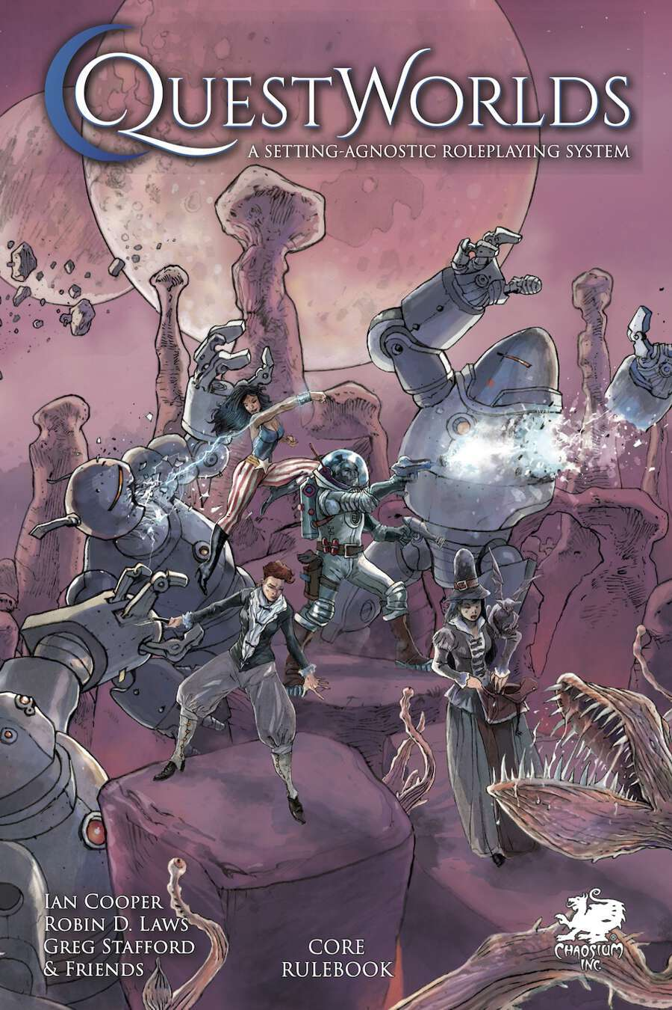
Our Running Example
QuestWorlds Contest System
Example domain
It has several procedures, but for this exercise, we will focus on modelling its simple resolution engine: contests.
https://www.drivethrurpg.com/en/product/509287/questworlds

Slide 24
RDD Design Story
"A GM wants to run a QuestWorlds contest with a player. They open the QuestWorlds website and generate a session ID, which they share with their players.
The GM creates a new contest by entering the prize and setting the Target Number for the resistance.
A player joins the session and records an ability they believe will help them overcome the obstacle and its rating.
The GM determines any stretch, situational modifiers, hindrances, and augments.
The system rolls a D20 for both the GM.
The system evaluates the results, adjudicates the winner, and determines possible consequences or benefits. The outcome is shared with the GM and the Player. "

Slide 25
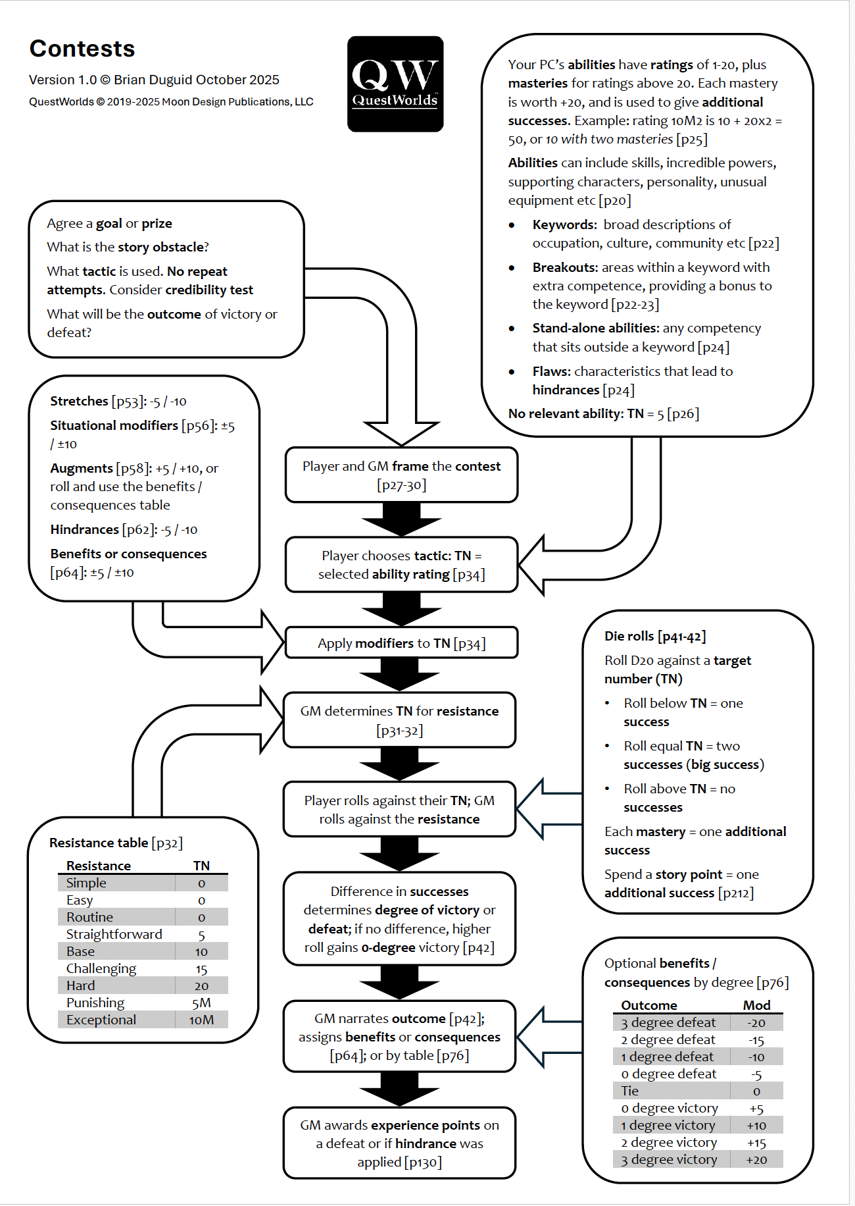

Slide 26
Finding Modules
Discovery techniques and review criteria

Slide 27
Module Discovery
Multiple approaches
Workflow Decomposition
Event Storming
BPMN
Actor/Action
Use Cases
Domain Storytelling
RDD
Both reveal candidate modules through different lenses
Notes:
This is the meat of the talk. How do you actually find modules? We'll look at two discovery approaches, then review criteria to check our work. The process is iterative - discover candidates, review against criteria, refine.

Slide 28
Workflow Decomposition
Follow the work through the system
Step 1
→
Step 2
→
Step 3
→
...
Each step = potential module
Identify the major steps in processing
Event Storming
Value Stream Mapping
BPMN diagrams
Good for: business processes, data flows
Notes:
Start with workflow - what are the major steps a user takes through the system? Each step is a candidate module. This comes from event storming and BPMN thinking. Don't worry about capturing every step initially - start with the major processing stages.
Reference: Event Storming, BPMN

Slide 29
QuestWorlds: Workflow
Following the contest flow
Session
→
Framing
→
Resolution
→
Outcome
Candidate modules from workflow:
Session, Framing, Resolution, Adjudication
But are these good modules? Need review criteria...
Notes:
Start with workflow - what are the major steps a user takes through the system? Each step is a candidate module. This comes from event storming and BPMN thinking. Don't worry about capturing every step initially - start with the major processing stages.
Reference: Event Storming, BPMN

Slide 30
Actor/Action
Who does what to whom?
Action
Target
Actor
performs
on
Who does what?
Use Case - Identify Actor and their Actions in Architecturally Significant Use Cases
Domain Storytelling - Actors perform Actions in Work Items
Good for: user-centric systems, clear responsibilities

Slide 31


QuestWorlds: Actors/Actions
creates
Contest
GM
frames
Prize
sets
Resistance
TN
determines
Ability
TN
Player
adds
Modifier
(Augment)

Slide 32
Actor/Action
Assign Responsibilities to Modules
Session
creates
Contest
GM
Framing
determines
Ability
TN
Resolution
Player
Outcome
Responsibility Driven Design - Pull out the themes from the narrative, assign responsibilities. Assign to object neighborhoods (modules).

Slide 33
Review Criteria
Apply these to candidate modules before committing
1. Parnas Test — Does it hide a decision?
- Encapsulating a design decision
- Key insight: a workflow is independent of the tasks in the workflow (tasks may be shared between workflows)
2. Coupling — How connected to other modules?
- Afferent coupling (who depends on me?)
- Efferent coupling (who do I depend on?)
- Measuring coupling as a review tool
3. Entity Trap — Did we just wrap an entity/aggregate lifecycle?
- Entity-centric decomposition causes problems
- Entities tend to be shared, creating coupling hotspots

Slide 34
The Parnas Test
Ask: "What decision does this module hide?"
"Begin with a list of difficult design decisions
or design decisions likely to change.
Each module hides such a decision from others."
✓ Clear answer → Good module candidate
✗ Vague answer → Reconsider the boundary
Key insight: A workflow is independent of the tasks in the workflow
QuestWorlds Example:
"Resolution hides the dice mechanics and success calculation"
Clear decision → Good module
Notes:
Now we review our candidates. Parnas says: what decisions might change? Hide those. The key insight for us: the workflow (the sequence of steps) is independent of the tasks (what each step does). So "roll dice" and "evaluate results" might be shared across different contest types, but the workflow that uses them could vary.

Slide 35
Coupling
Simple module dependencies
Afferent (Ca) — Who depends on me?
Efferent (Ce) — Who do I depend on?
High afferent: Many dependents → harder to change
High efferent: Many dependencies → more reasons to change
Lots of types of coupling but only limited time in this talk.
Goal: Minimize coupling while maintaining cohesion

Slide 36
Measuring Coupling
Measure module dependencies
Total Coupling = Ca + Ce
Ca = 1
C
Ca = 0
Ca = 0
Ce = 2
A
Ce = 1
B
Ct = 1
Ct = 1
Ca = 1
Ct = 3
D
Ca = 0
Module A: Ca=0, Ce=1, CT=1
Module B: Ca=1, Ce=2, CT=3 ← review this one
Module C: Ca=1, Ce=0, CT=1
Module D: Ca=1, Ce=0, CT=1
High CT = potential problem
Ca = 1
Ct = 1
Notes:
Simple arithmetic. Add up afferent and efferent for total coupling. High total coupling modules are the ones to review - they're either doing too much, or they're in the wrong place in your architecture. Tools like NDepend can calculate this for you in real codebases.

Slide 37
The Entity Trap
A common mistake
Symptom: Modules named after data entities UserManager, OrderService, ContestHandler
Problem: Hides data structure, not decisions
Result: Behavior scattered across "managers"
Better: Modules named after capabilities or decisions
Framing, Resolution, Outcome
Note: Can be hard to avoid entirely. Our Framing module is centered around an aggregate ContestFrame because we need to capture the data other modules use.
Notes:
The structural problem: when you organize around entities, every workflow that touches that entity creates a dependency. Contest is in everything. So changes to how contests work ripple everywhere. Contrast with organizing around workflows - each workflow owns its view of the contest it needs.

Slide 38
QuestWorlds: After Review
Applying our criteria
Session — hides session lifecycle, player connections
Framing — hides implementation of contest setup, replaceable (risk: aggregate)
Resolution — hides dice roll + success calculation (incl. masteries)
Outcome — hides degree → consequences mapping and delivery
Reference: QuestWorlds Contests flowchart

Slide 39
Organizing Modules
How do we structure modular applications

Slide 40
Organizing Modules
Multiple principles, different properties over “best” or ”worst”
Technical – Organize by their technical role
Flow – Organize by the flow of data
Domain – Organize by their domain role
Notes:
We've found our modules. Now: how do they relate to each other? There are two main families of organization - technical and domain. Neither is inherently better; they optimize for different things.

Slide 41
Technical Architectures
Separate technical infrastructure (user interface and data)
Layers (User, Service, Domain, Infrastructure)
Ports & Adapters (Adapter, Port, Application)
In essence: rules about which modules may depend on which other module

Slide 42
Ports & Adapters (Hexagonal)
Technical architecture partitions are not modules, they contain them
HTTP
→
P
P
→
DB
Application
CLI
→
P
P
→
Queue
Ports = form sockets you can plug into Adapters = plug in to ports
Driving = activates our domain Driven = activated by our domain
Driven Adapters = Modules, Ports façade to modules
Application = One to Many Modules (see later), Driven Ports façade to modules
Notes:
Ports and adapters: your domain is in the center, defining ports (interfaces) for what it needs. Adapters on the outside implement those ports for specific technologies. Want to swap your database? Write a new adapter. The domain doesn't know or care. Good for: systems with multiple UIs or infrastructure that might change.

Slide 43
Flow-Based Architectures
Data moves through transformation steps; modules have input/output ports
Pipes & Filters – data source and data sink, operations/filters
Flow Based Programming – data flows between behaviors
In essence: modules are behavioral transformations

Slide 44
Pipes & Filters / Flow-based
Input
→
Filter A
→
Filter B
→
Filter C
→
Output
Each filter:
Module, input/output façade to module
Single transformation
Independent, composable
No knowledge of neighbors
Good for: data processing, ETL, event streams

Slide 45
Domain Architectures
Organize around business capabilities
Vertical Slice
CQRS
In essence: modules are organize our domain, architecture organized around domain use cases

Slide 46
Vertical Slice
Feature-based organization
Create
Contest
Join
Session
Resolve
Contest
UI
Logic
Data
UI
Logic
Data
UI
Logic
Data
Each slice: layers for one capability
Often implemented by folders, but this lacks modular structure, leading to risk of common (pathological) coupling.
This is really layers, but by use case
In principle, each slice contains multiple modules depending on implementation approach (transaction script, domain, etc.) and support for information hiding

Slide 47
CQRS
Command Query Responsibility Segregation
Commands
Queries
↓
↓
Write Model
Validation
Business Rules
Read Model
Optimized
for display
↓
↓
Write DB
Read DB
Different models, different optimization
Key here is that we may have different modules for same domain on read and write sides
Typically Command Handlers and Query Handlers form the façade to a module.
They allow us to hide much of the implementation of that behavior.
As such they help decouple a module from its consumers.

Slide 48
Hybrid Architectures
Turtles all the way down
We often nest structures:
Within a pipes and filters architecture each filter may be a ports and adapters architecture.
Within a vertical slice architecture a slice might be implemented as a CQRS architecture where a handler forms a façade to a domain module.
Within a CQRS architecture, command handlers might be driving ports into a ports and adapters architecture.
The key is to understand that your architecture should not be expressed via modules, instead your modules are organized within an architecture. And don’t rely on folders.
Most of these organization schemes are closer to each other than their advocates would admit.

Slide 49
QuestWorlds: Which fits?
Ports & Adapters
Domain logic in center, divided into multiple modules
Adapters for storage, UI

Slide 50
Working with Modules

Slide 51
Working with Modules
Deep modules have narrow interfaces.
Narrow interfaces pay off in multiple scenarios:
Testing - smaller surface, stable contracts
Feature Flags – can block an entire module
Deployment – can provide a different version of a module to a percentage of deployments
AI assistance - bounded context, clear specs

Slide 52
Testing at Module Boundaries
TDD with Modules
Test the interface, not the internals
Test
→
Module Interface
→
(hidden impl)
Module boundary = natural test boundary
Test behavior, not implementation
Refactor freely inside
No excessive mocking

Slide 53
AI Assistants and Modules
Why modular code suits AI assistants:
✓ Boundary for agent activity
✓ Clear interfaces to implement against
✓ Generateable in isolation
✓ Verifiable in isolation
✓ Reduces Merge Conflicts to public interface changes only
Breaking work into smaller units helps AIs with cognitive load (context management) just like people.

Slide 54
AI Assistants and Modules
Why modular code suits AI assistants:
✓ Boundary for agent activity
✓ Clear interfaces to implement against
✓ Generateable in isolation
✓ Verifiable in isolation
✓ Reduces Merge Conflicts to public interface changes only
Breaking work into smaller units helps AIs with cognitive load (context management) just like people.

Slide 55
Feature Flags
Controlling deployments by module
Modules allow optionality
Simple decision, module on or off.
Complex decision, features in module, on or off
Caller must assume optional module might not return values
Far easier to control optionality at module boundary than spread throughout code

Slide 56
Deployment
Controlling deployments by module
Modules allow us to configure with different versions
Allows canary deployments with feedback narrowed to specific change.
We can try a wholly different approach, provided it implements the same facade

Slide 57
Modular Monoliths and Microservices
Modules are not just for Modular Monoliths
Modular Design is about maintainability
Modules are not domains (or bounded contexts)
Domains (or bounded contexts) are not modules
Modules are a distinct concept in DDD from bounded contexts. A bounded context may have many modules. Modules in the domain should highlight domain concepts.
Both monoliths and microservices may have many modules
“The MODULES in the domain layer should emerge as a meaningful part of the model, telling the story of the domain on a larger scale.”
Evans, Eric; Domain Driven Design

Slide 58
Wrap Up

Slide 59
The Journey
Requirement
→
Modules
→
Organization
→
Usage
Take a requirement
Discover modules (workflow, actor/action)
Review modules (Parnas, coupling, entity trap)
Choose organization (technical vs domain)
Work with modules (TDD + AI)
Modular software is simpler to author and maintain
Notes:
Let's recap the journey. Start with a requirement. Discover candidate modules using workflow and actor/action analysis. Review them against Parnas's information hiding, coupling metrics, and watch for the entity trap. Choose an organization that fits your problem. Then work with your modules using TDD, and leverage AI assistants effectively. The thesis holds: modular software is simpler.

Slide 60
References & Further Reading
Parnas: "On the Criteria to Be Used in Decomposing Systems into Modules" (1972)
Yourdon & Constantine: Structured Design (1979)
Richards & Ford: Fundamentals of Software Architecture
Riel & Metz: Head First Software Architecture
Khononov: Balancing Coupling in Software Design• Ousterhout: A Philosophy of Software Design

